Slide 1
Practical Class: Week 2
Look Ahead and Setting Expectations
Chapters 2 and 3: Organisational Capability and Stakeholder Management
Competencies: Stakeholders – Scope – Time – Cost – Quality – HR – Communication – Risk – Procurement – Integration

Slide 2
Some Helpful Student Services
UniAccess
The Living Room
Study Smarter
International Student Support Team
Robin Winkler Clinic
Guild student assist
IT SOS Scheme
Notes:
UniAccess – physical or mental health conditions, neurodivergent, disabilities, carers– temporary or ongoing: take stress out of needing special consideration (alter exam conditions, allow extra time for assignments, student support assistants e.g. note takers, makes course materials more accessible
The Living Room – drop in student wellbeing space at shenton house – feeling lonely, stressed, upset, unsure about study, worrying – provides free short term support and information (sometimes there are therapy dogs) and yoga
Study Smarter – improve writing, communication, presentation, English, maths, stats, time management etc. drop in sessions or one on one consultations
International Student Support Team: settling in and adjusting to life, support services, visa issues, fee issues, referrals to professionals
Robin Winkler: cheap - (final year) psychologists for uwa students – group and individual sessions - $20, shorter wait times
Guild student assist: Social workers independent from the uni offer help with welfare and finances, financial support: short term no interest loans, the pantry (free food and necessities no questions asked)

Slide 3
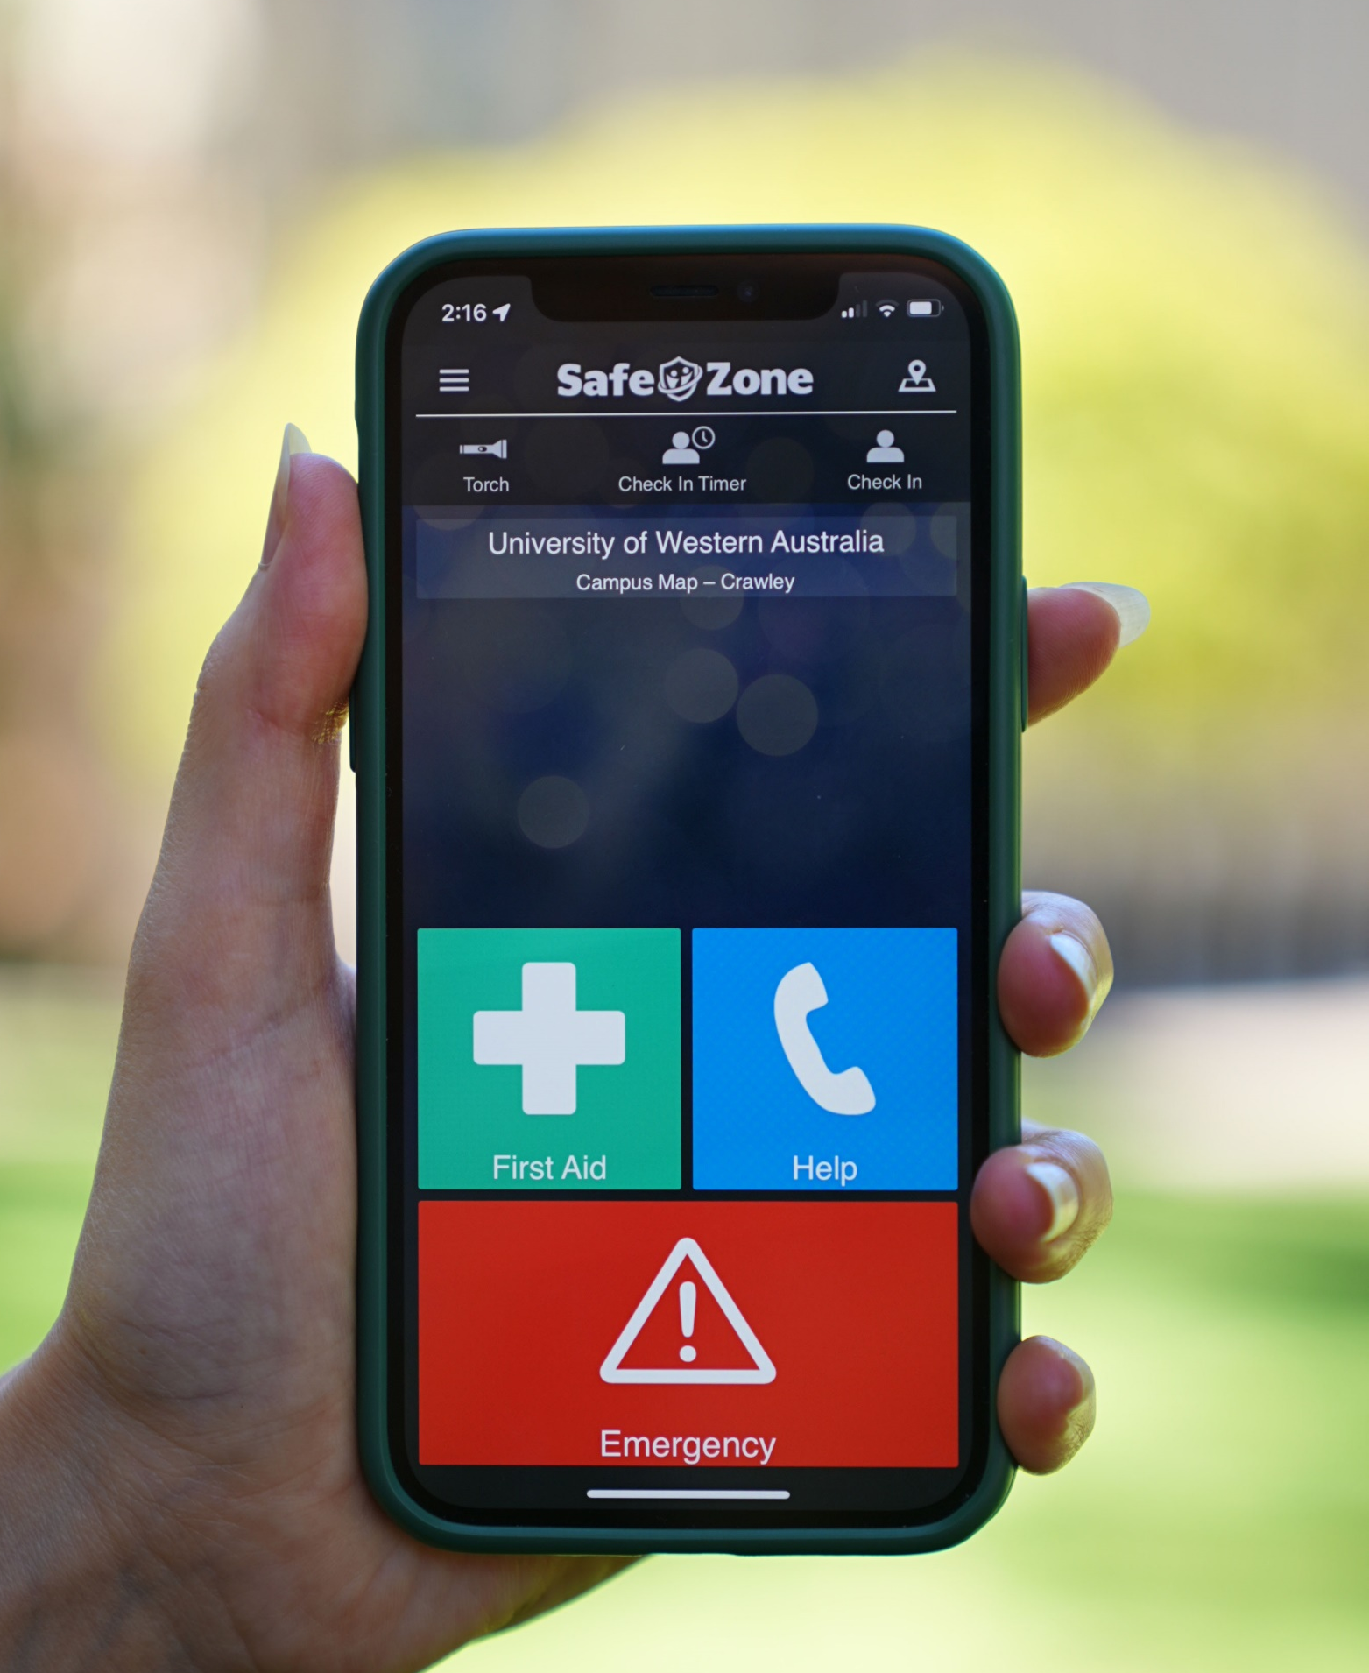
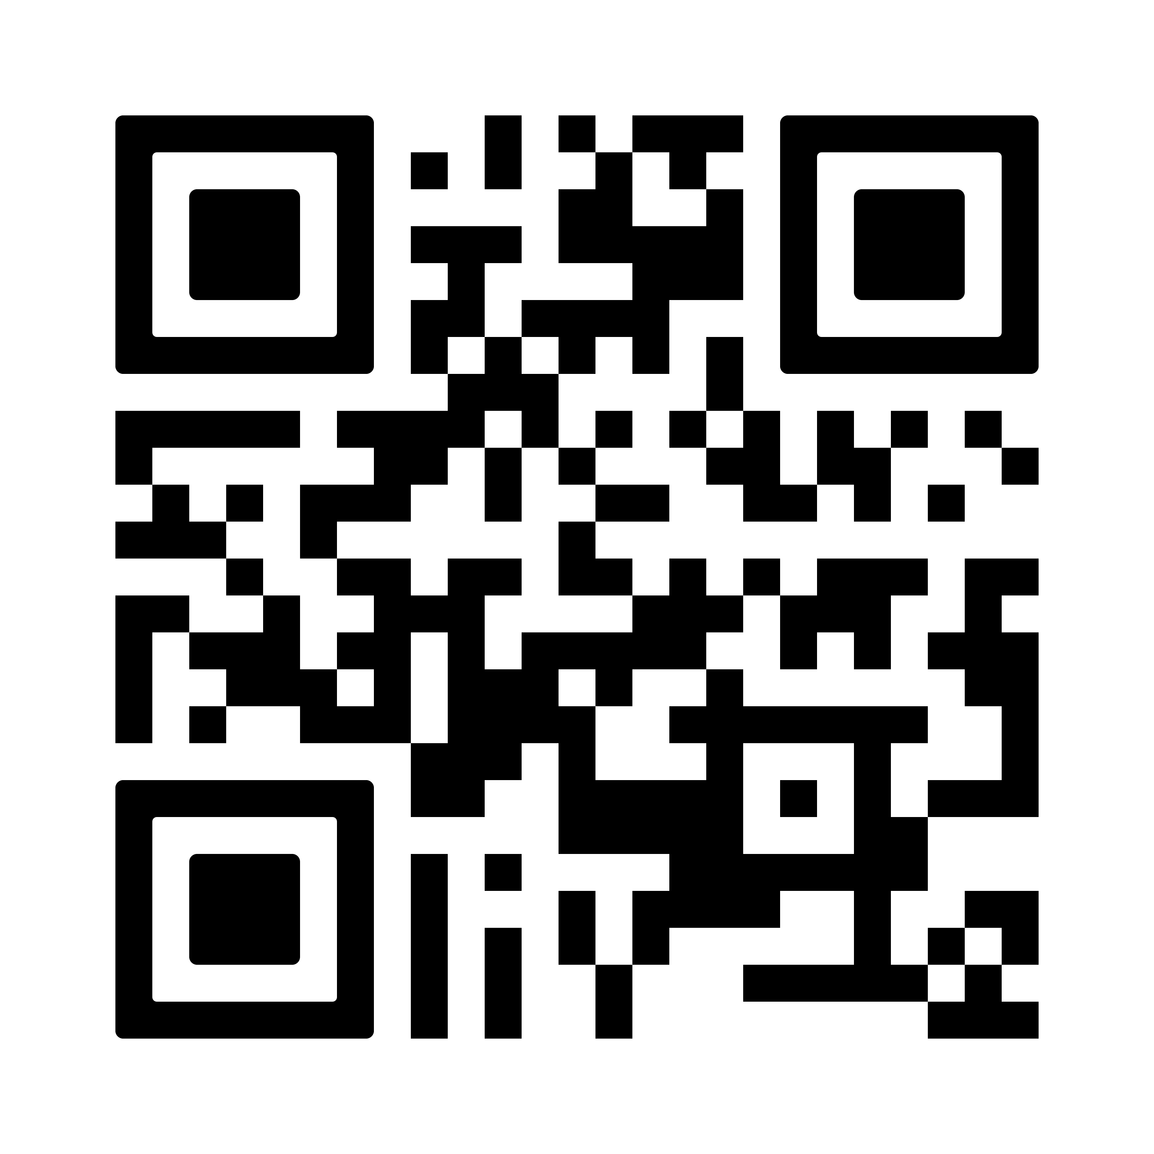
Stay safer at UWA with SafeZone
With the simple press of a button, you’ll be connected directly with UWA Security if you ever need help on campus, 24/7.
First aid
Non-urgent assistance
Emergency help
Notifications
Campus map
Download today!

Slide 4
Practical Class Structure
Week 1 – 6: Project Management Theory
Each week dedicated to different project management competency
Overviews of important topics/muddiest concepts*
Class discussions on relevant case studies from the textbook
Major Group project check ins
Week 7-8: Break
Major group project submission
Week 9 – 12: Ethics in Project Management
Each week focuses on difference concepts of ethical theory/practice
Overviews of important topics/ethical frameworks
Class discussions on case studies and ethical dilemmas in engineering
Exam review

Slide 5
Class Expectations
Flipped classroom approach
Complete case study readings before coming to class (available in unit readings on LMS)
Conduct group meetings regarding your project outside of class
Behaviour
Be respectful of group members’ ideas and contributions
Engage and participate to the best of your abilities
Escalation of issues:
Reach out to group member
Raise with class facilitator (via email or after class)
Raise with Cosi
Request formal peer review (these are not to be taken lightly)

Slide 6

Unit Readings and Weekly Check-Ins

Slide 7
Farrell Reflection Model
A framework for conducting your own, informal, team reflections
PLAN
REVIEW
FEEDBACK
Decide how to conduct the reflection
Conduct the reflection
Present feedback and self-reflect
RESPOND
Discuss feedback and set new goals
Week 2
Week 4 or 5
NB: This model is not an assessable part of the unit; its intent is to assist you with team management.
Notes:
PLAN
Self-reflection and consideration of goals, team members, progression, and code of conduct
Questions to ask:
What aspects of the team will you be reviewing?
What format will you be delivering the feedback?
How often will you be repeating the cycle?
e.g.:
Aspects for review: punctuality, preparedness for meetings, flexibility, listening to others’ ideas, completing tasks on schedule
Format: Pen and paper feedback given during team meetings
Frequency: Once halfway through assignment and once a week before the due date
REVIEW
Conduct review of chosen aspects of team progression, attitude, areas for improvement, etc
e.g.:
Written comments on each aspect up for review
Numerical scale from 0 to 5 for each aspect of review
Grade similar to assignment grades: NP,P,C,D,HD
FEEDBACK
Present team members with feedback using format previously decided upon
NB: Give each member a chance to silently reflect on feedback and compare it to their self-reflection. Potentially conduct ‘respond’ session separately or provide feedback over Teams/Messenger the day before your team meeting.
RESPOND
Have a team discussion to consider and respond to feedback
Questions to consider :
Does everyone agree with the feedback they were given?
Are there disputes or misunderstandings?
What are your tangible goals for moving forward?
What will you improve as an individual?
What will you improve as a team?
Make sure you document these goals and outcomes.

Slide 8

Major Group Project Weekly Goals
It’s important for your group to set your own short-term milestones
These are suggestions and can help ensure you’re on track to complete by the deadline
Week 2: Choose project
Week 3: Reach out to stakeholders/manager/etc.
Week 4: Most research/information gathered
Raise with me if you haven’t found enough information online or heard back from stakeholders yet
Week 5: Writing underway
Week 6: Plan presentation structure
Week 7: Create and record presentation

Slide 9
Chapter 2: Organisational Capability
Case Study Questions:
What factors would have triggered the organisation to engage a project management consultant in the first place?
What recommendations do you think Justin should put forward and how would each one benefit the project and the organisation?
Is it really such a major issue that standard operating procedures are used ‘exclusively’ in planning and managing projects? Justify your answer.
Justin identified a number of governance issues impacting the organisation’s project management practices. How could each of those cited be improved and what would be the direct benefit to the project and the organisation?
What might the organisation look like when it achieves Level 2 project management maturity?

Slide 10
Chapter 3: Stakeholder Management
Case Study Questions:
What is the connection between stakeholder management and project success?
Why does Marty think that simply identifying project stakeholders isn’t enough in order to ultimately engage, manage and control them?
Planning for stakeholder management implies that ad hoc communication will not work. Justify this assertion.
Why does Marty think stakeholder management is a process over time and not a point in time?
What information would Marty capture in a stakeholder management matrix?

Slide 11
Check-in and Reminders
One Page Summary:
Email to Cosi by: Friday 8th March, 5pm
Weekly Check-In:
Available: Tuesday 5th March
Where are you at with your group project?
Have you chosen your project?
Have you finished your one-page summary?

